Slide 1
Data Representation in Machine Learning
BY. KISOMOSE Tonny
+256780501609

Slide 2
Data Representation
In today’s world, a lot of data is being generated on a daily basis. And sometimes to analyze this data for certain trends, patterns may become difficult if the data is in its raw format. To overcome this data visualization comes into play. Data visualization provides a good, organized pictorial representation of the data which makes it easier to understand, observe, analyze.
The word data refers to constituting people, things, events, ideas. It can be a title, an integer, or anycast. After collecting data the investigator has to condense it into a tabular form to study their salient features. Such an arrangement is known as the presentation of data.
It refers to the process of condensing the collected data into a tabular form or graphically. This arrangement of data is known as Data Representation.
Notes:
Salient features are the most important or distinctive qualities of something

Slide 3
Data Visualization with Python
Python provides various libraries that come with different features for visualizing data. All these libraries come with different features and can support various types of graphs. In this tutorial, we will be discussing two such libraries.
Matplotlib
Seaborn
Notes:
We will discuss these libraries one by one and will plot some most commonly used graphs.
Dataset: Tips database is the record of the tip given by the customers in a restaurant for two and a half months in the early 1990s. It contains 6 columns such as total_bill, tip, sex, smoker, day, time, size

Slide 4
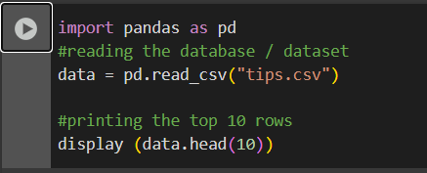
Viewing the dataset – using pandas

Slide 5
Matplotlib
Matplotlib is an easy-to-use, low-level data visualization library that is built on NumPy arrays. It consists of various plots like scatter plot, line plot, histogram, etc. Matplotlib provides a lot of flexibility.
To install this type the below command in the terminal.
pip install matplotlib

Slide 6
Seaborn
Seaborn is a high-level interface built on top of the Matplotlib. It provides beautiful design styles and color palettes to make more attractive graphs.
To install seaborn type the below command in the terminal.
pip install seaborn
Seaborn is built on the top of Matplotlib, therefore it can be used with the Matplotlib as well. Using both Matplotlib and Seaborn together is a very simple process. We just have to invoke the Seaborn Plotting function as normal, and then we can use Matplotlib’s customization function.
Note: Seaborn comes loaded with dataset such as tips, iris, etc. but for the sake of this tutorial we will use Pandas for loading these datasets.

Slide 7
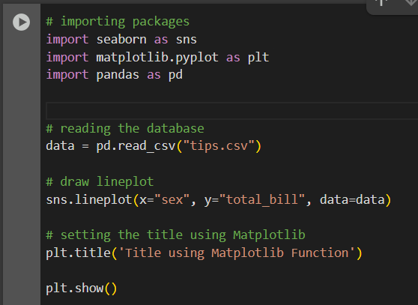

Slide 8
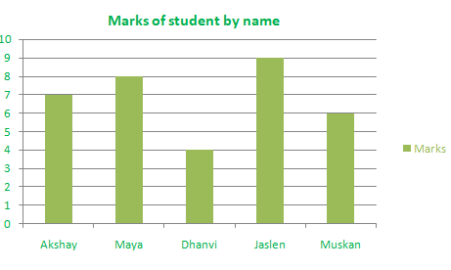
Types of Graphical Data Representation
Bar Chart
Bar chart helps us to represent the collected data visually. The collected data can be visualized horizontally or vertically in a bar chart like amounts and frequency. It can be grouped or single. It helps us in comparing different items. By looking at all the bars, it is easy to say which types in a group of data influence the other.

Slide 9
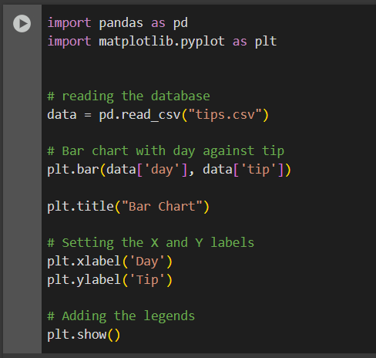

Slide 10
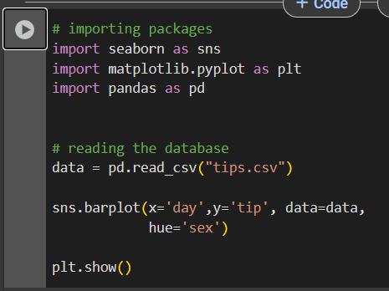
Using seaborn

Slide 11
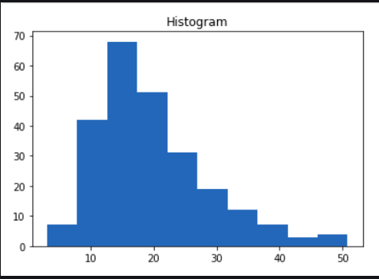
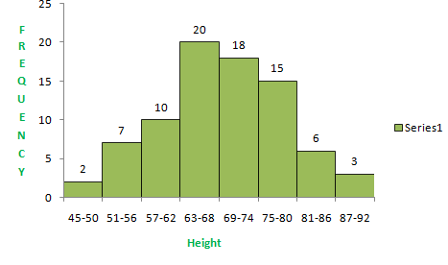
Histogram
A histogram is the graphical representation of data. It is similar to the appearance of a bar graph but there is a lot of difference between histogram and bar graph because a bar graph helps to measure the frequency of categorical data. A categorical data means it is based on two or more categories like gender, months, etc. Whereas histogram is used for quantitative data.

Slide 12
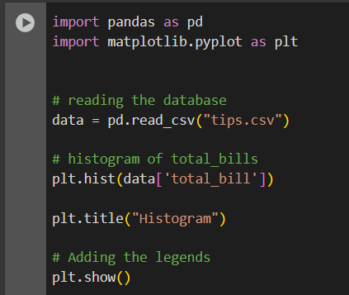

Slide 13
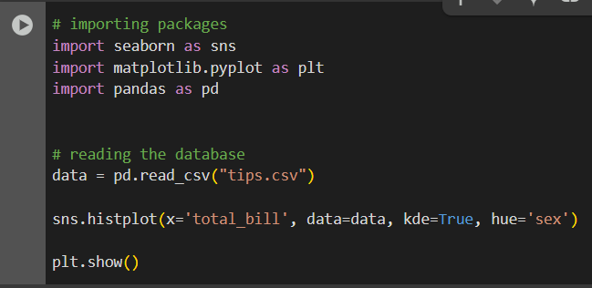
Using seaborn

Slide 14
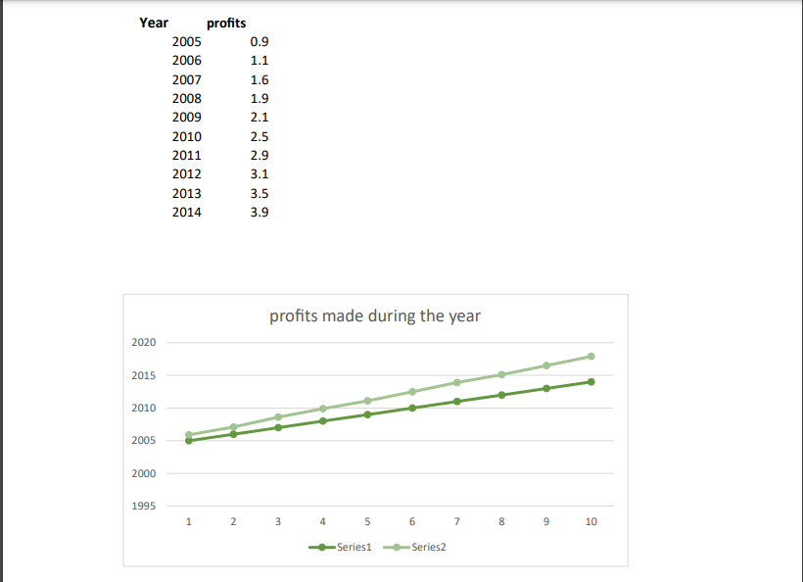
Line Graph
The graph which uses lines and points to present the change in time . Line graphs can be based on the number of animals left on earth, the increasing population of the world day by day, or the increasing or decreasing the number of bitcoins day by day, etc. The line graphs tell us about the changes occurring across the world over time. In a line graph, we can tell about two or more types of changes occurring around the world.
Line Chart is used to represent a relationship between two data X and Y on a different axis. It is plotted using the plot() function. Let’s see the below example.

Slide 15
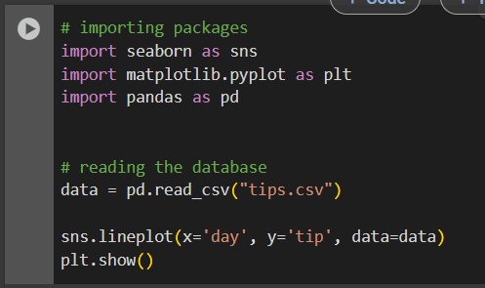

Slide 16
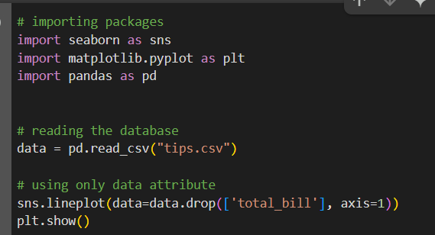
Type 2

Slide 17
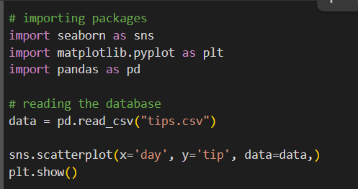
Scatter Plot
Scatter plots are used to observe relationships between variables and uses dots to represent the relationship between them. The scatter() method in the matplotlib library is used to draw a scatter plot.
Example
Notes:
You will find that while using Matplotlib it will a lot difficult if you want to color each point of this plot according to the sex. But in scatter plot it can be done with the help of hue argument.

Slide 18
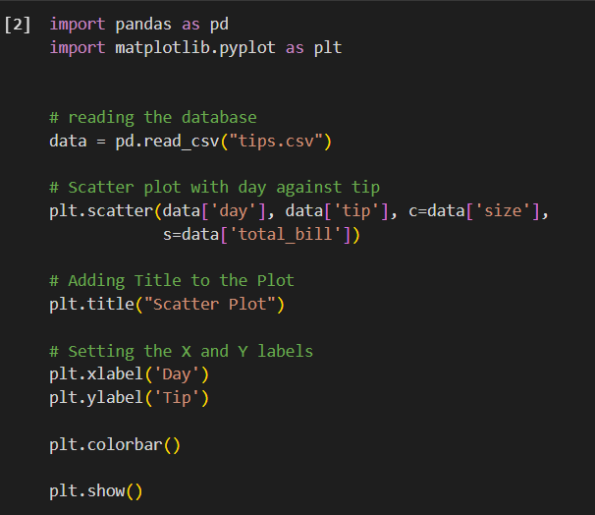
Adding color to the plot

Slide 19
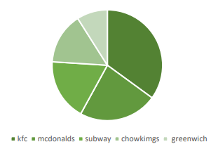
Pie Chart
Pie chart is a type of graph that involves a structural graphic representation of numerical proportion. It can be replaced in most cases by other plots like a bar chart, box plot, dot plot, etc. As per the research, it is shown that it is difficult to compare the different sections of a given pie chart, or if it is to compare data across different pie charts.

Slide 20
Q&A

